Slide 1
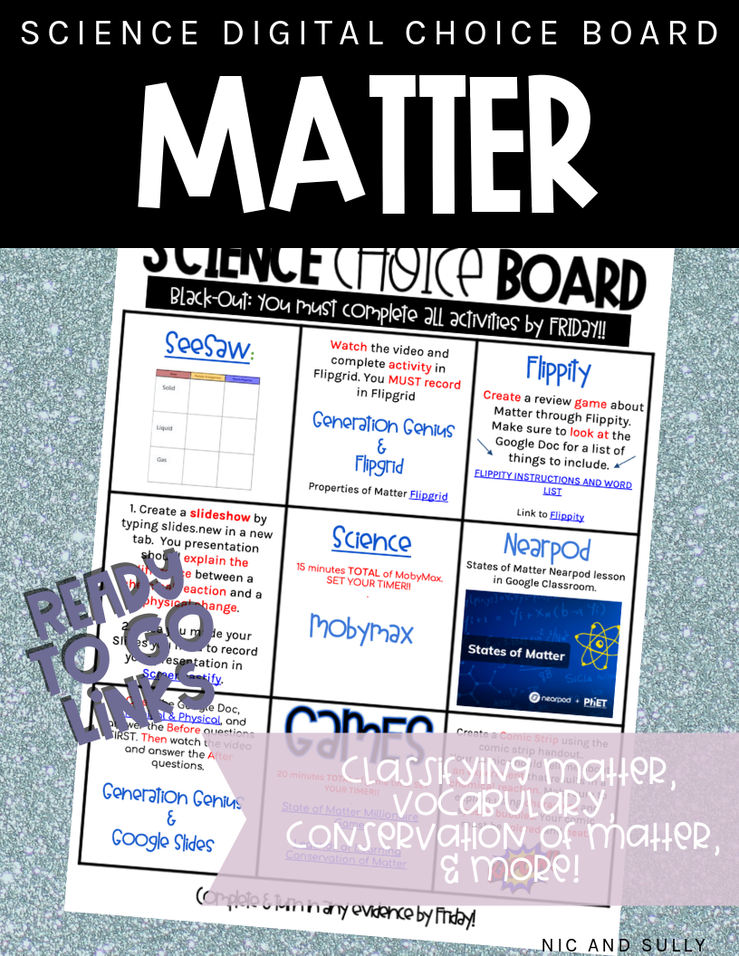

Slide 2
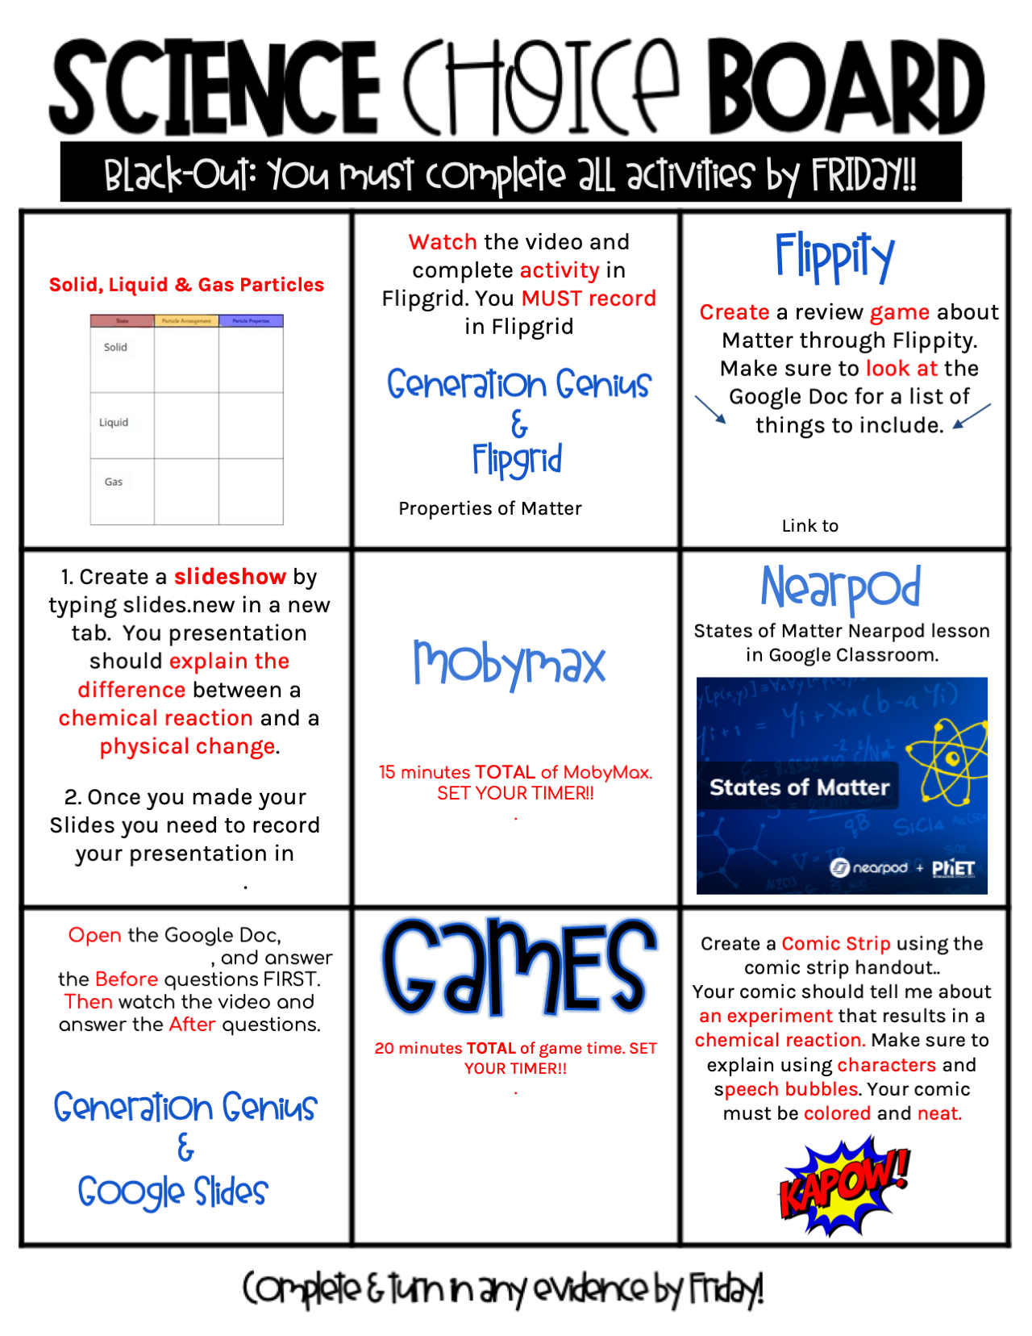
PREVIEW
SeeSaw:
PREVIEW
FLIPPITY INSTRUCTIONS AND WORD LIST
Flippity
Flipgrid
PREVIEW
Science
PREVIEW
Chemical & Physical
State of Matter Millionaire Game
Legends of Learning Conservation of Matter
Notes:
Links are provided; please see blue underlined parts in the board above. Please remember the links are editable. You can change them out to direct students to your specific seesaw assignment, flipgrid topic, etc.
This is a “Black-Out Choice Board.” This means students will complete ALL tasks.
Below you can find information about several tasks/activities.
1. Seesaw activity link to add to your Google Classroom or other LMS: https://app.seesaw.me/activities/xl74f6/solid-liquid-gas-particles
2. Please note that Generation Genius is a paid program. We cannot provide the links to the 2 videos. This is a link to check out Generation Genius for yourself (it has been referred to as the “next Bill Nye.” There is a 14 day free trial; you could be strategic about signing up when you want to use this choice board. 😉
Another option for this task is to replace these videos with a YouTube video that fits your need. Change out the questions on the Google Doc and replace the hyperlink if you will NOT be using Generation Genius.
3. Nearpod: This program does have free access, but the student paced mode needed for the purpose of this task is only included as part of the paid subscription. Lessons may also be individually purchased based on the needs of your classroom if you do not have a subscription to Nearpod. Here is the link to the lessons we used in this choice board. Phet is an AMAZING tool that Nearpod has partnered with. It is definitely worth the purchase!
4. MobyMax: If you do not have access to MobyMax, replace with your district’s equivalent. You may sign up for Mobymax for free and your teacher account will just have fewer features if your school or district does not have an account. Another great option is to insert an entire square for Legends of Learning. This website is ENTIRELY free!! It includes gamified science standard practice/reinforcement that require you to “launch” the lesson. Please message us if you need some help with launching! You will not be disappointed if you choose to use this resource.
5. Flipgrid: Under your class grid, create a topic and title it “States of Matter.” The assignment/instructions should include the following: “Create a video that explains the different states of matter to a Kindergarten student. Remember a Kindergarten student needs visuals to learn, and it also helps to explain using words they are familiar with.”
6. Comic Strip: We have included the comic strip resource! YAY! BONUS!

Slide 3
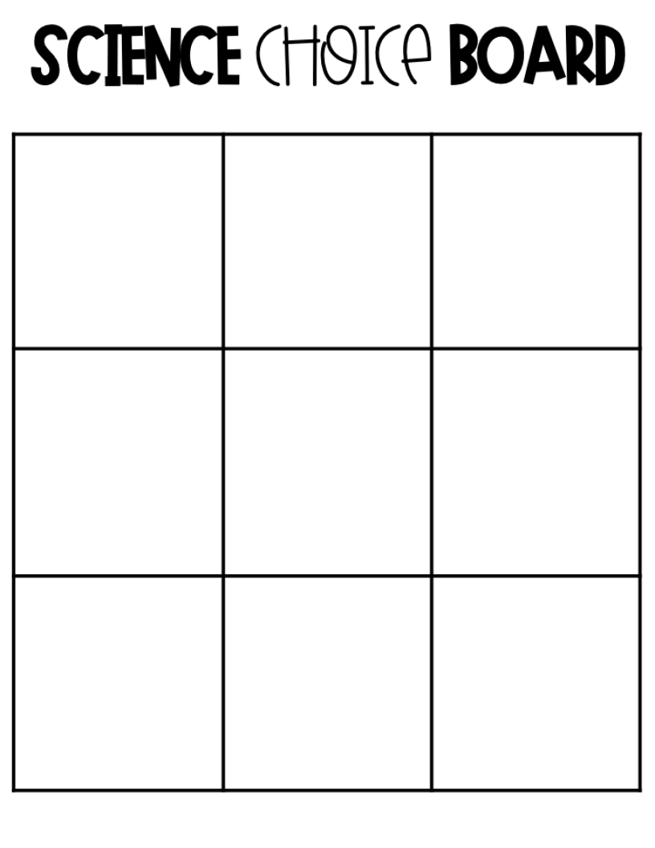
PREVIEW
Type Choice Here.
Type Choice Here.
Type Choice Here.
PREVIEW
Type Choice Here.
Type Choice Here.
Type Choice Here.
PREVIEW
PREVIEW
Type Choice Here.
Type Choice Here.
Type Choice Here.

Slide 4
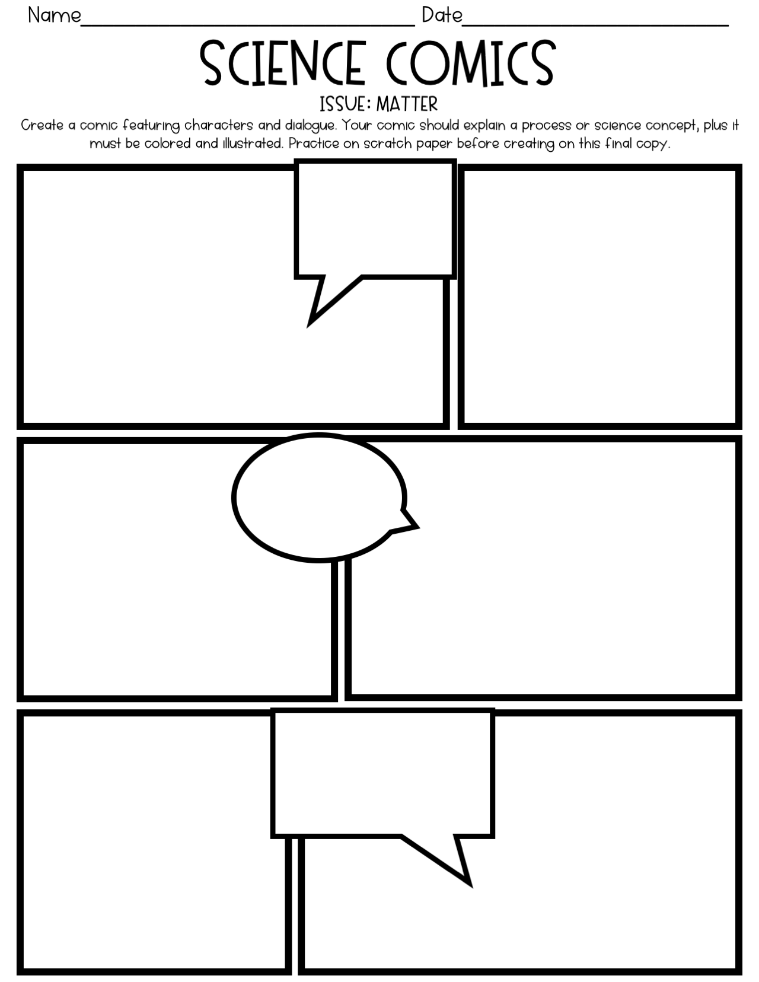
PREVIEW
PREVIEW
PREVIEW
PREVIEW

